Slide 1
The Trade: Paul vs. Westbrook
NBA DATA ANALYSTS:
Sanjay Suresh, Mitsuko Kitazawa, Nicolas Gomez Bustamante, Nicholas Keller

Slide 2
Agenda
About the Trade project
Data source
Analysis approach
Results
Conclusions

Slide 3


About the Trade project
Last season’s Rockets point guard was Chris Paul (34 years old)
This off-season Paul was traded to the Thunders for Russel Westbrook (30 years old) – additional draft picks were sent
The objective of our project was to compare players to one another statistically to see if one stands above the other

Slide 4
Data
The data used for this analysis was pulled using an API client package that pulls from stats.nba.com
This data is recorded by the NBA, so it is therefore the most accurate
We had to quickly learn a couple of the different endpoints used

Slide 5
Analysis Approach
Comparative analysis used career stats from Westbrook and Paul, merged them by Season and Age, matplotlib plots were used to support the analysis
Linear Regression was used to first find a correlation between a common player stat (Plus Minus(+/-)) and a players Win Percentage since winning is the goal
We then used linear regression to see if there was a correlation between a players +/- and the other stats a player records

Slide 6
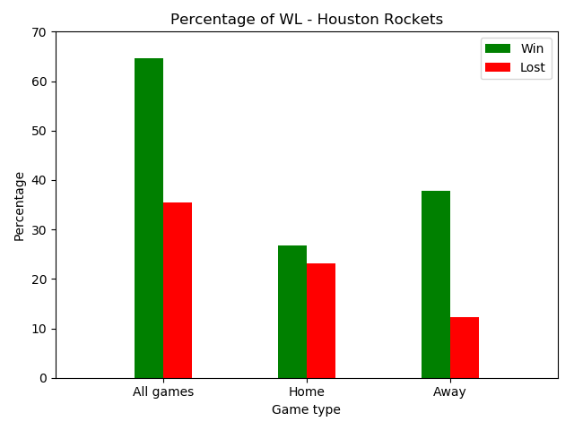
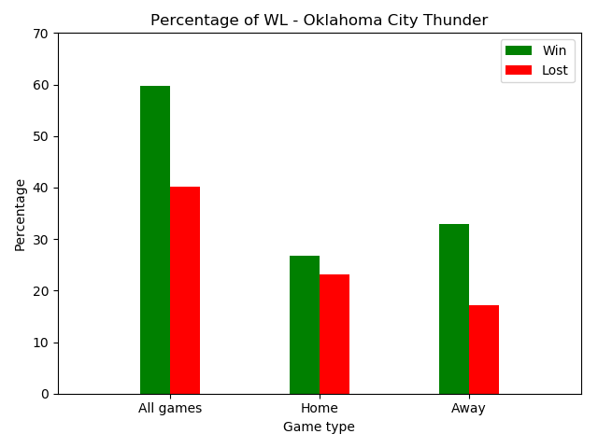
Results Team Comparative Analysis
Rockets in general had higher number of wins than Thunders
Both teams were a better away team
Their records overall were similar

Slide 7
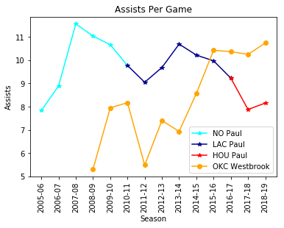
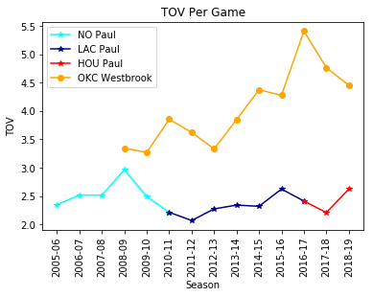
Results Comparative Analysis
- Paul is declining in Assists whereas Westbrook is improving
- Paul protects the ball better than Westbrook (High TOV is bad)
Notes:
2016-2017 Westbrook was the only superstar in OKC (KD left and before PG was traded to OKC)

Slide 8
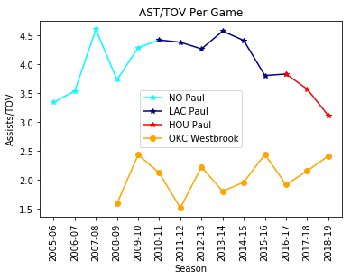
Results Comparative Analysis
- Paul has clearly shown the ability to protect the ball and prevent turn-overs at the point guard position.
- Westbrook has been slowly improving, this is not his strong suit.

Slide 9
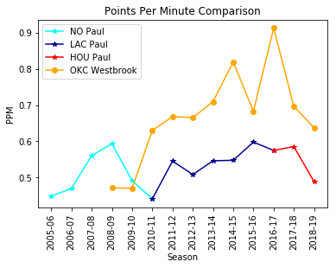
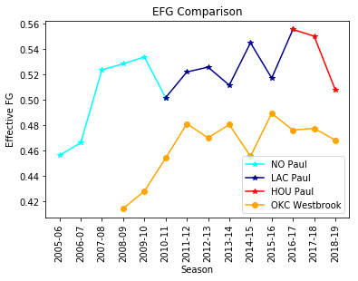
Results Comparative Analysis
- Westbrook is a more prolific scorer
- Paul is a more accurate shooter

Slide 10
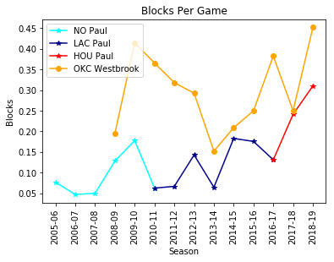
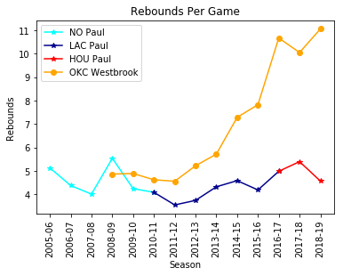
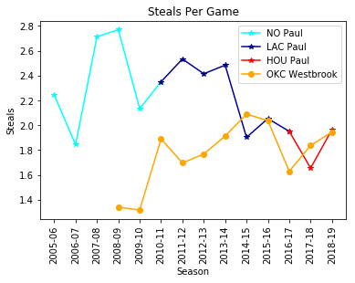
Results
Westbrook outperforms Paul in blocks and rebounds
Paul has been able to accumulate more steals over his career, however they were tied at the age of 30

Slide 11
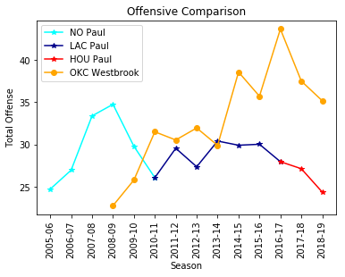
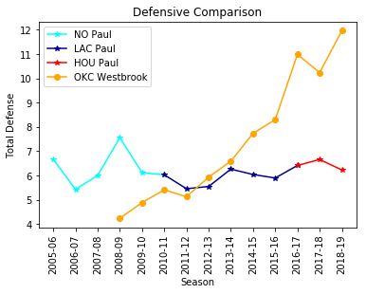
Results Comparative Analysis
Points + Assists + Offensive Rebounds
Steals + Blocks + Defensive Rebounds
Statistically on Offensive and Defensive indicators, Westbrook has surpassed Paul

Slide 12
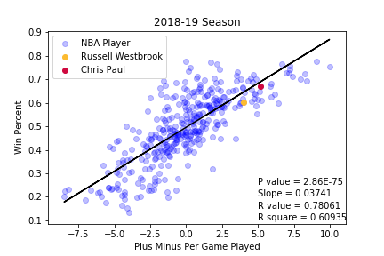
Regression Analysis
*players with >500 minutes played
Significant Correlation between a players plus minus and their win percent

Slide 13
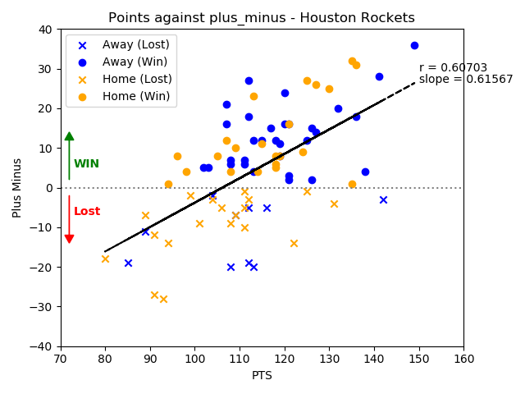
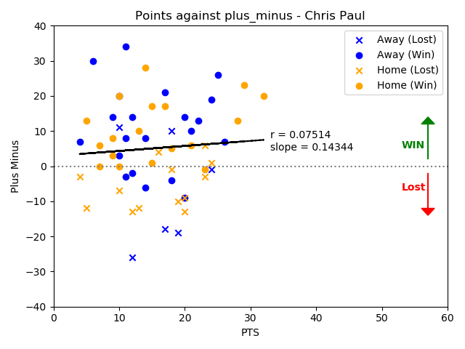
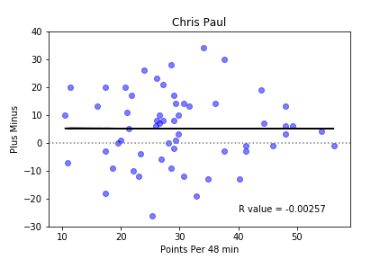
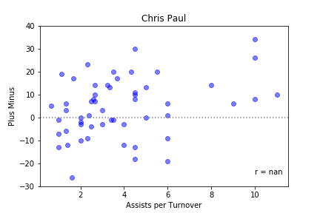
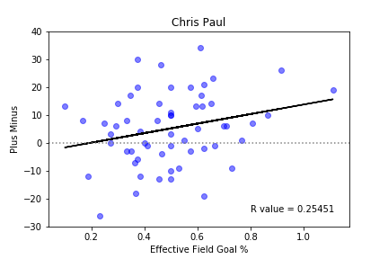
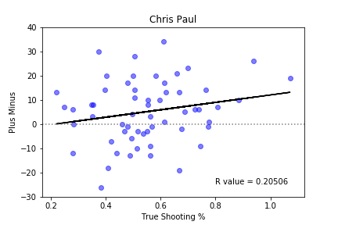
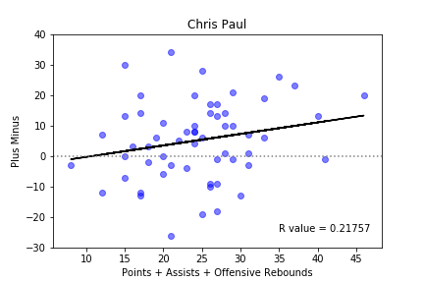
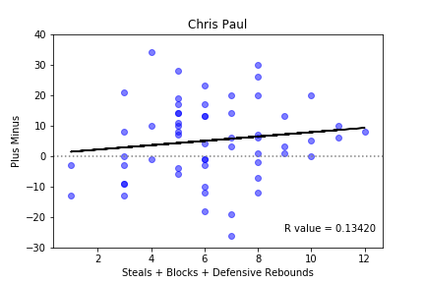
Chris Paul and Rockets 2018-2019

Slide 14
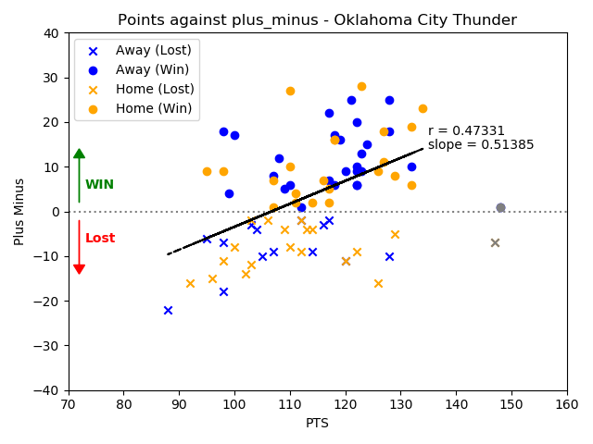
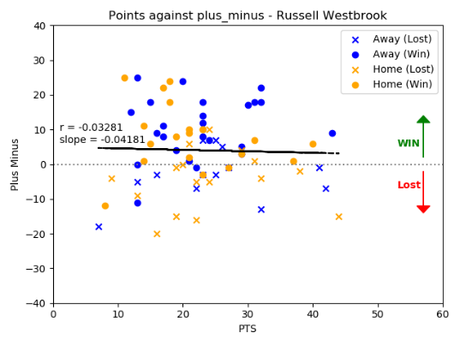
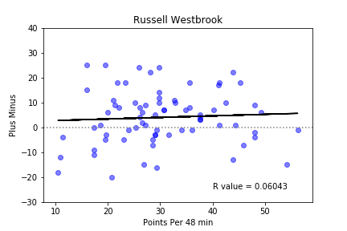
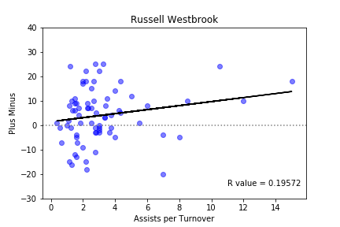
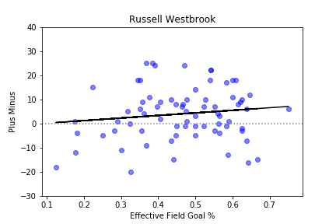
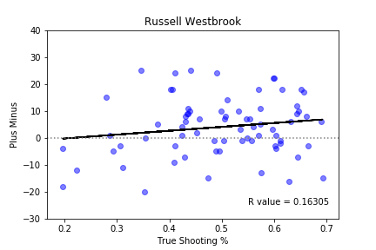
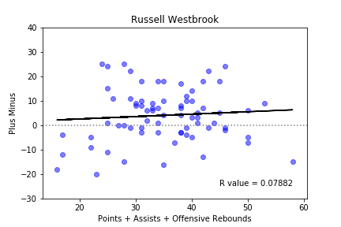
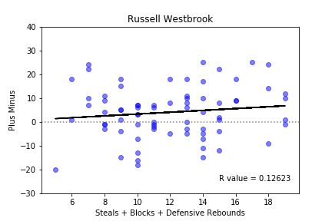
Russell Westbrook and OKC 2018-2019

Slide 15
Conclusions
Westbrook fills a different type of role than Chris Paul does because of how different the 2 players are
At this point in their careers, Westbrook provides the most value based on his statistics on the offense and defensive side of the ball
Westbrook regularly scores more points and rebounds more balls in a game than Chris Paul, which provides more opportunities for his team to score.
The statistical analysis shows us that there are many variables in a basketball game that can make it impossible to quantify players against players that are in different situations on their team
Notes:
Use the controversy in the MVP trophy, and bench happiness as an example

